Slide 1

Easy Farm
An intuitive and engaging software for farming advice.

Slide 2
Project Objectives
Creating an application for farmers to easily explore, analyze, and utilize NASA datasets to improve their farming practices.
User-friendly interface for easy access to farmers.
Integrate the NASA datasets in the application in the most efficient way.
Helping farmers throughout the crop cycle by different techniques.

Slide 3
Introduction To Easy Farm
Incorporates NASA databases to deliver real-time, reliable information about weather, land, and climate.
Effective crop selection based on climate, temperature, soil type, soil moisture, and rainfall.
Monitoring of soil health, weather, and crop health.

Slide 4
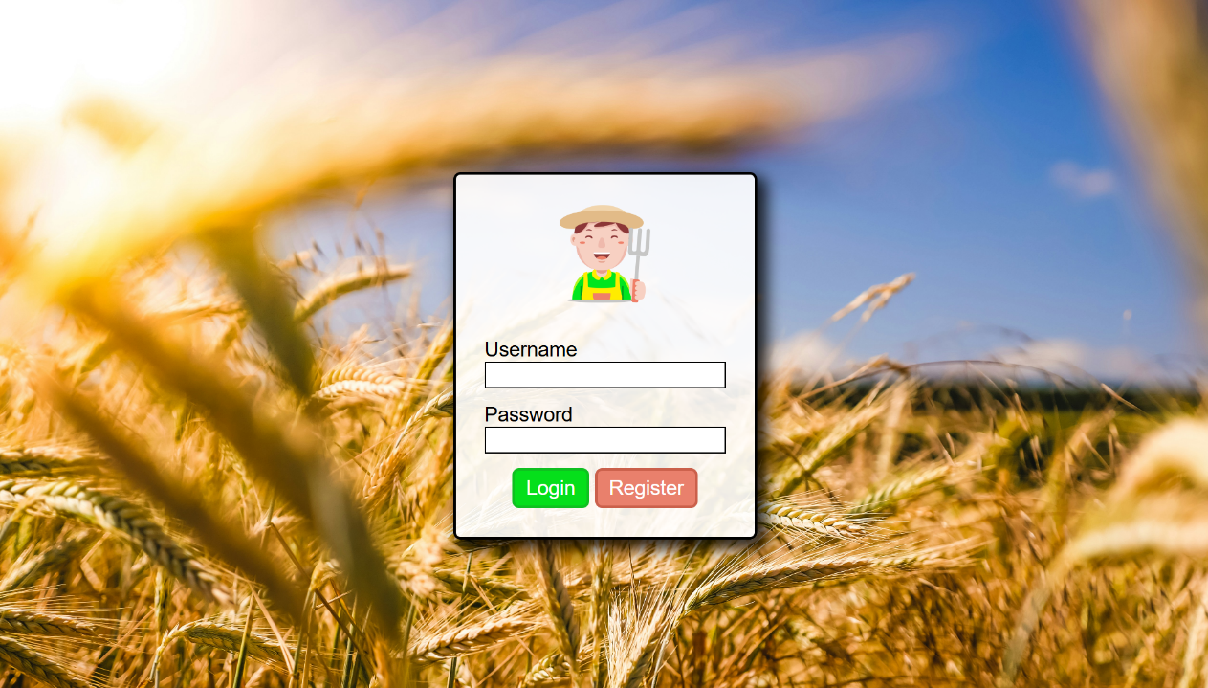
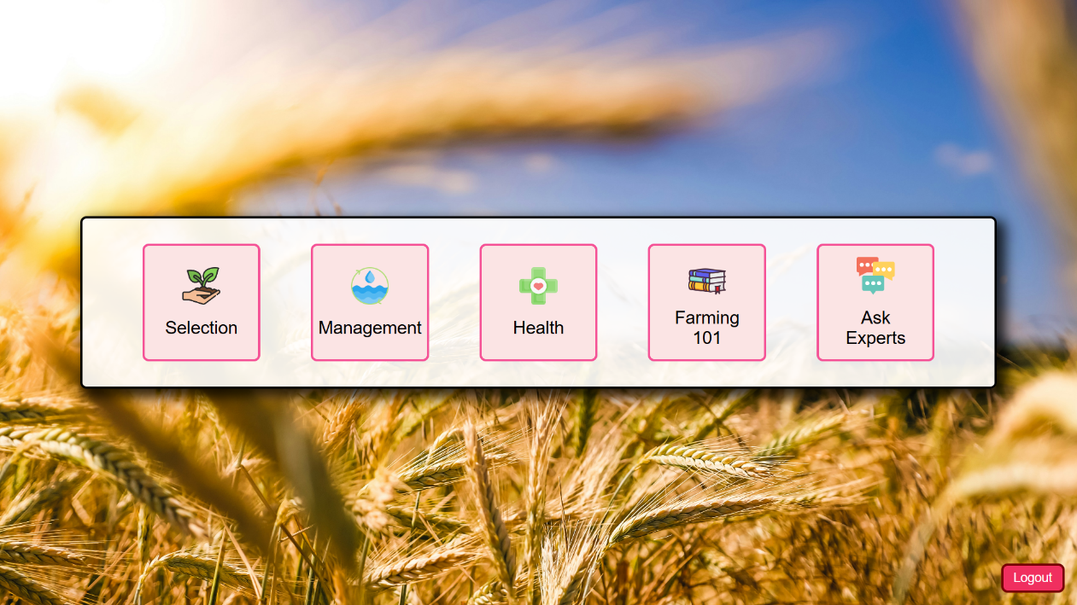
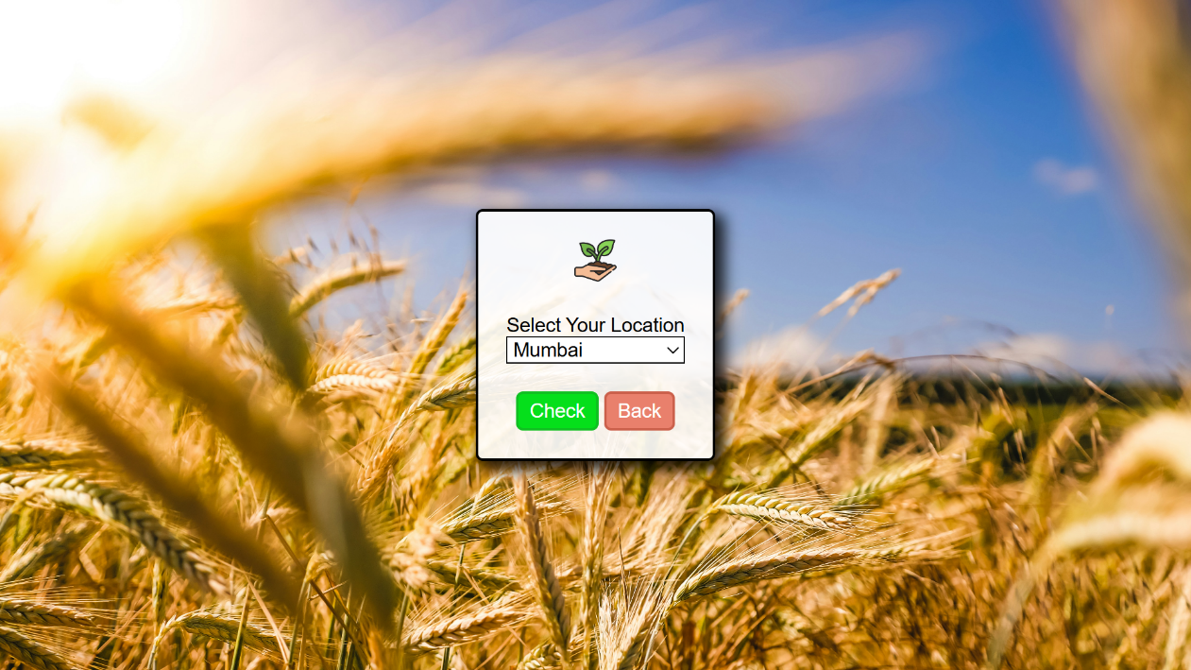
Easy Farm Interface

Slide 5
Tech Stack
Front-End
HTML5
CSS3
JavaScript
Back-End
Python3 (Django)
MySQL
NASA’s Earthdata Developer API

Slide 6
Application Benefits
Production Rate: Through highly accurate prediction.
Improve Water management: Through monitoring rainfall and Humidity patterns.
Disaster Prediction: Through use of NASA DATASET, which can then be notified to the Farmers through the app in advance, so farmers can take preventive measures.

Slide 7
References
https://www.earthdata.nasa.gov/lehttps://en.wikipedia.org/wiki/Climate_of_Indiaarn/get-started
https://www.earthdata.nasa.gov/engage/open-data-services-and-software/api
https://docs.djangoproject.com/en/5.1/
https://www.w3schools.com/css/
https://developer.mozilla.org/

